Slide 1


Communication Skills part 1
Week 3:
Description
Coherence and cohesion-1
Reflective journal

Slide 2
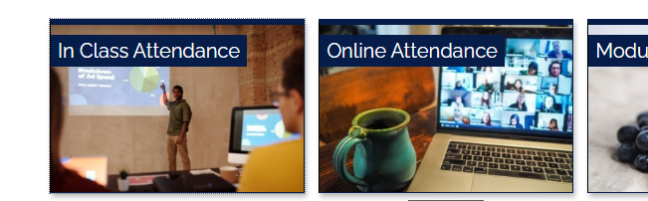

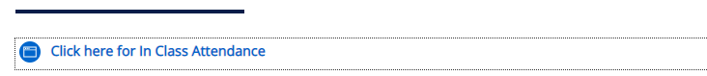

Registering your in Class attendance
Step 1: Ensure you are logged into the ARUL-Wi-Fi.
The password is: 1nt3rn3t@Arul
Step 2: Login to the VLE and go to the module page for your class.
Step 3: Click on In Class attendance
Step 4: Click on the link highlighted in blue. The word submitted will appear on your screen if you have followed the procedure
Step 5: Repeat this process for your AM/PM class
Notes:
Get all students to register their attendance for todays WW session
This is the process they will follow for attending classes next week, but they need to select the module they will be studying

Slide 3
Learning outcomes
By the end of this session, you will have:
Discussed the first element in Gibbs’ reflective model – Description.
Identified and practiced strategies to improve coherence and cohesion in written texts.
Discussed reflective journal and its importance / relevance in reflective writing. **notes

Slide 4
Homework - Reading
You were asked to read pp. 7-13 (Getting started on reflective writing) in your coursebook Reflective Writing.
Discuss the following in groups of 3 or 4.
What are some of the common confusions students may have in relation to reflective writing?
How might tutors or lecturers try to resolve these issues?
According to the authors, all kinds of reflective writing will have reflection on 6 elements. Which are these elements?

Slide 5

Element 1. Description

Slide 6
1. Description
In the description phase, you say what you are going to reflect on and what actually happened. You can address questions such as what, where, when etc. that are related to describing.
Helpful questions:
When and where did it happen?
What happened?
Why were you there?
Who was present? others
What did you and the other people do?
What was the outcome of the situation?
What did you hope or want to happen?
225 words min
Notes:
Source: https://www.ed.ac.uk/reflection/reflectors-toolkit/reflecting-on-experience/gibbs-reflective-cycle

Slide 7
Example description
Go to Activity 1 in Week 3 worksheet.
Read the example Description and discuss the following questions in groups of 3 or 4.
1. Does the paragraph effectively and fully describe the writer’s first day at work?
2. Is the paragraph clear, readable and logically structured? How/Why?
3. Identify the techniques the writer has used to make the paragraph coherent (means linked together, readable and easy to follow)? Find examples of each of these techniques.
4. Would you expect to see the writer express their feelings and thoughts, evaluate and analyse in this paragraph? Why/not?
5. If you were asked to write this paragraph again, how could you do it better?
Notes:
Give students about 15 minutes. Possible answers have been given in the following slide.

Slide 8
Independent homework - Week 3 Writing
Choose one of the following aspects of your ARUL student life and write a Description of it in about 225 words. Bring your paragraph to class next week.
Materials and activities used in your lessons/lectures
cortex/worksheets/in class writing.
ARUL campus facilities and amenities
computers, lecture rooms,
Involvement and participation in your lessons/lectures
(This is only your week 3! You will have more ARUL experiences and reflections in the coming weeks, and more to write about too).

Slide 9

Coherence and cohesion

Slide 10
Coherence and cohesion
This is the second of the four marking criteria to be used to assess your work.
Read the following explanation, use the internet if necessary and then share your understanding of the terms Coherence and Cohesion with your friends.
Academic writing demands that your texts are both cohesive and coherent. Cohesive writing is writing that ‘sticks together’; the language flows easily and smoothly from one phrase to the next, from one sentence to the next, from one paragraph to the next. Coherent writing is also writing that ‘sticks together’; but here it is ideas that flow logically, so your text can be easily interpreted by the reader, so that it doesn’t require the reader to guess how you reached your conclusion.
Notes:
www.arts.ac.uk/pre-sessional-English-core-materials.html

Slide 11
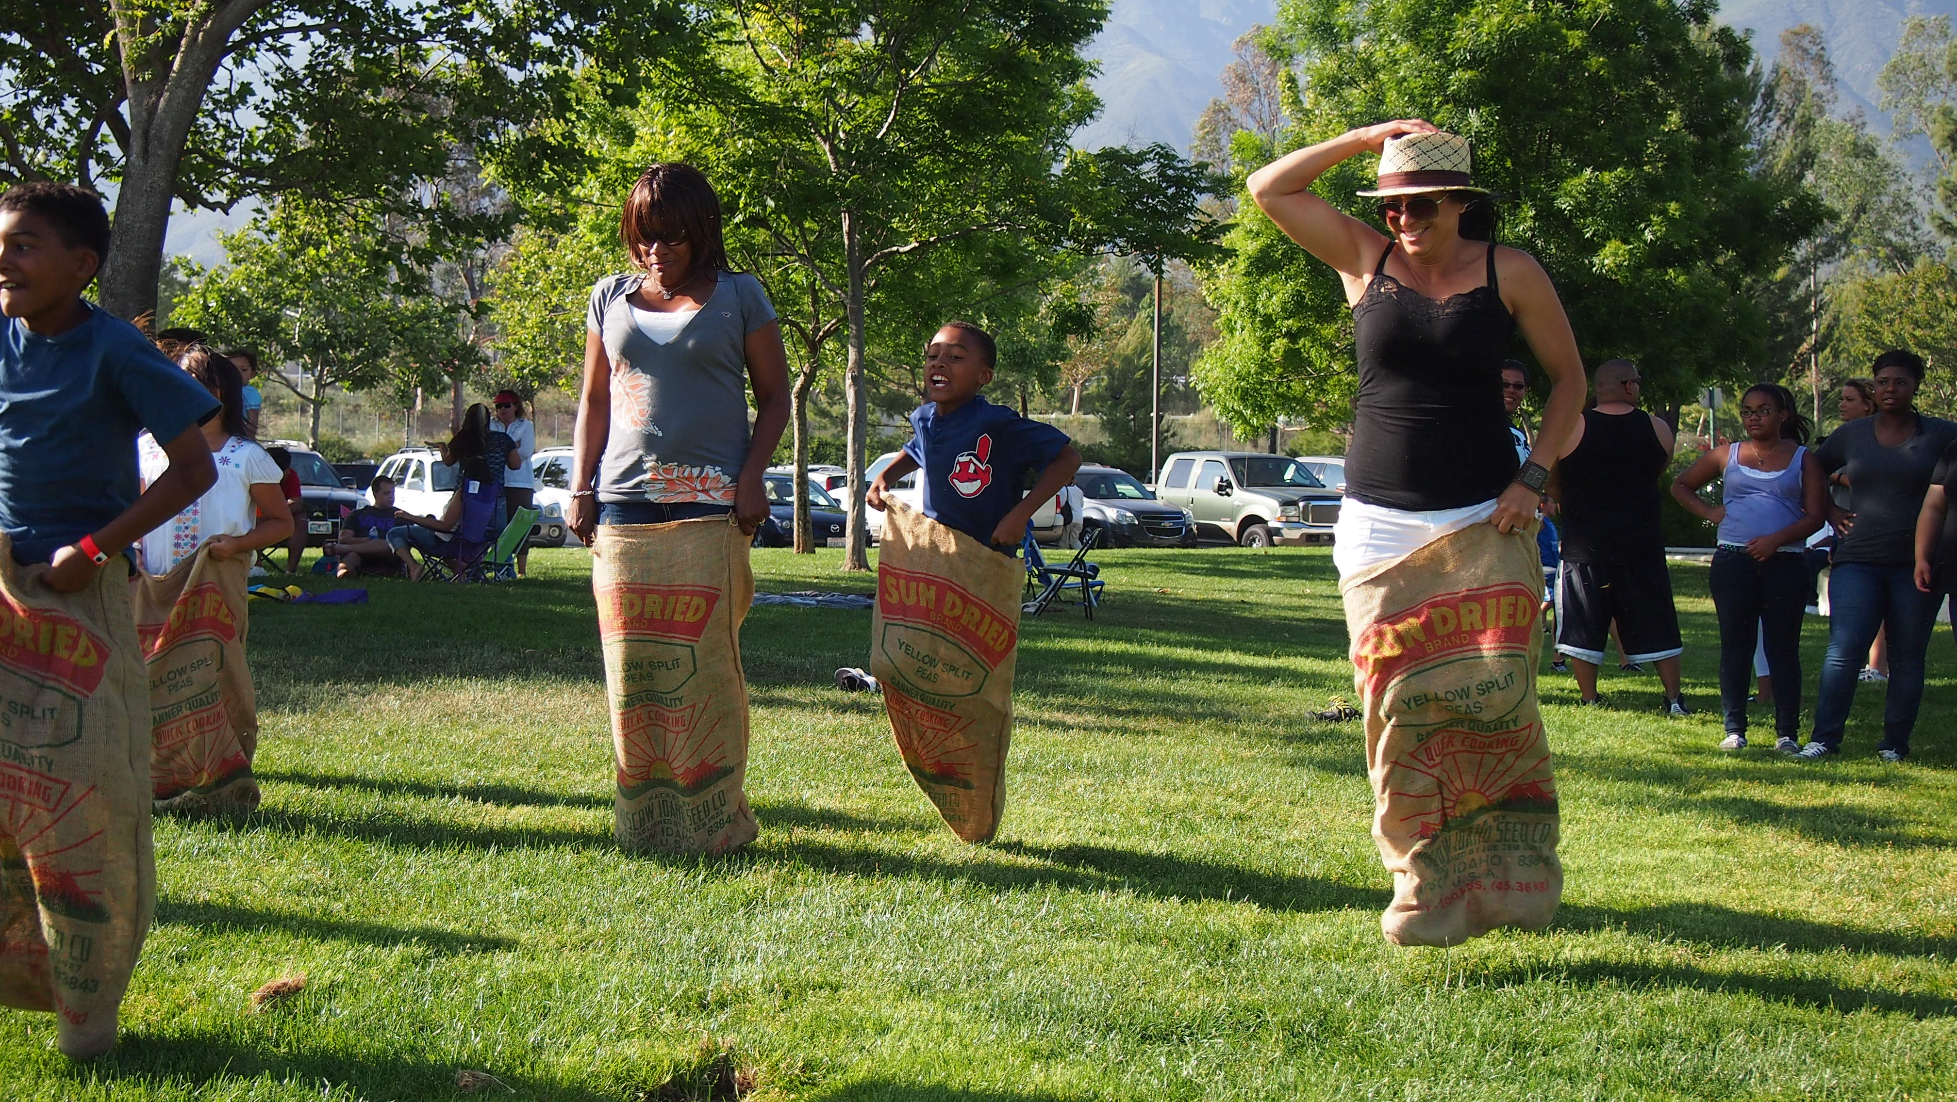
Why not cohesive/coherent?
Open Week 3 worksheet from VLE and do Activities 2 and 3 as instructed.
The answers to Activities 2 / 3 may be provided by your lecturer.

Slide 12
Cohesive devices
We have briefly seen some cohesive devices in activities 2 and 3, namely:
Linking words and phrases (however, firstly, on the other hand, likewise, similarly, the next, then, finally etc,)
Pronouns and reference words (he/his/him, she/her, you/yourself/yourselves, they/their/them, this/these, that/those, it/its, which etc.)
Repeating key words
Conjunctions and conjunctive phrases (and, or, but, because, for, that, although, despite that, due to etc.)

Slide 13

Cohesive paragraph
Go to Activity 4 and complete it in pairs/groups.
Answers to activity 4 may be with your lecturer.

Slide 14

Break: max. 15 mins

Slide 15


Linking words

Slide 16
Linking words - examples
Look at these linking words. Have you used them? Are any new to you?
Reason (because): Due to / Owing to / Stemming from the fact that, Since, As, Subsequently
Addition (and): Moreover, Furthermore, In addition, Also, Above all
Result (so): Therefore, Hence, Thus, Accordingly, As a result, Consequently
Purpose (so that): In order for, The aim of this essay is to
Comparison (like): Similarly, Likewise, In comparison
Contrast (but): However, Despite this, Nevertheless, In contrast, On the other hand, Yet, Although, While, By contrast
Notes:
https://www.canterbury.ac.uk/students/docs/study-skills/resource-8-Signposting-Words.pdf

Slide 17
Activity 5: Using linking words
Based on the previous slide and information provided on the Research Skills modules, complete the Cambridge Assessment English ‘Linking words’ quiz by clicking here OR the link below.
Answers will be provided after each question has been answered.
www.cambridgeenglish.org/learning-english/activities-for-learners/b1w005-linking-words
Linking words | Learning English | Cambridge English

Slide 18
Reflective Journal

Slide 19
Reflective journal / diary Research-Pair-Share
Using some of the websites on next slide, find out:
What is a reflective journal? What is its purpose and usage?
What do you write in a reflective journal?
How useful a reflective journal will be for your CS1 assignment?
Do you keep a reflective journal? If not, are you going to start writing one? What for / When / How often will you use it?
What tips would you give to your friend with respect to keeping a reflective journal?
Then pair up with another person and compare your answers. Finally share your ideas/thoughts with the rest of the class.
Notes:
Give students around 20 minutes for this activity. There are no answers provided to this task.

Slide 20
Websites – Reflective journal
https://warwick.ac.uk/fac/cross_fac/iatl/study/ugmodules/humananimalstudies/assessment/reflectivejournal/
http://www.docs.hss.ed.ac.uk/iad/Learning_teaching/Academic_pastoral/Reflect/Keeping_reflective_journal.pdf
https://www.toppr.com/bytes/reflective-journals-writing/
https://journey.cloud/reflective-journal/
https://www.intelligentchange.com/blogs/read/reflective-journal-how-to

Slide 21
Reflective journal / diary
In summary, a reflective journal is a very useful aid for reflective practice /writing. It:
develops learner autonomy and self-direction.
helps you monitor and develop your study / study techniques.
helps you remember what you have considered worth noting down.
enhances commitment to yourself and your future plans.
integrates reflection and facilitates professional practice.
helps you evaluate, analyse and consider different perspectives of what you have observed or experienced.
gives you a means to build on your own and others’ work.
helps you learn from your experiences and develop yourself to be a better practitioner.

Slide 22
Homework – Writing – Week 2
Your writing homework was to write the Introduction element of reflective writing on one of the following topics:
Materials and activities used in your lessons/lectures
ARUL campus facilities and amenities
Involvement and participation in your lessons/lectures
Work in pairs and look at each other’s work. Tell your friend what you like about their work and how they can do even better.
Have they introduced the topic?
Is there background information? Does it flow from general to specific?
Is the thesis statement clear?
Have they given an outline of the work?
Notes:
Give about 10 minutes for this stage.

Slide 23
In-class writing practice
In light of the feedback you have received from your friend on the Introduction of your RW, make necessary changes to it. If you are unsure of anything, ask your lecturer.
Then save your Introduction on your device so that you can use it later for your final submission.
Notes:
Give about 10 minutes for this stage.

Slide 24


Slide 25
Independent study
Go to the ‘Independent study’ section under the Week 3 tile
READ: Reflective writing:
pp. 39-48 ( A reflective diary or learning journal) (Click on the link on VLE or open the PDF attached)
ANSWER: Homework Quiz 3 on VLE
WRITE: Week 3 Independent Study Writing Activity
WATCH: Videos in ‘Week 3 Preparation Resources’

Slide 26
References
www.arts.ac.uk/pre-sessional-English-core-materials.html Bailey, S., 2017. Academic Writing: A Handbook for International Students. 5th ed. s.l.:Routledge. BBC, 2021. Presentations: language expert. [Online] Available at: https://www.bbc.co.uk/worldservice/learningenglish/business/talkingbusiness/unit3presentations/expert.shtml [Accessed 29 September 2021]. Rochester Institute of Technology, 2021. Reference Words. [Online] Available at: https://www.rit.edu/ntid/sea/processes/referencewords/intro [Accessed 29 September 2021]. Massey University, 2021. Signpost words and phrases. [Online] Available at: https://owll.massey.ac.nz/pdf/studyup-essays-2-handout.pdf [Accessed 29 September 2021]. https://www.ed.ac.uk/reflection/reflectors-toolkit/reflecting-on-experience/gibbs-reflective-cycle https://create.kahoot.it/details/d21f60f8-a811-4f41-91af-2cd69033122c www.Sheffield.ac.uk/eltc https://www.canterbury.ac.uk/students/docs/study-skills/resource-8-Signposting-Words.pdf www.cambridgeenglish.org/learning-english/activities-for-learners/b1w005-linking-words University of Hull, 2021. Signposting. [Online] Available at: https://canvas.hull.ac.uk/courses/371/pages/signposting [Accessed 29 September 2021]. University of Southampton, 2021. Coherence and cohesion (online). Available at www.ed.ac.uk/reflection/reflectors-toolkit/reflecting-on-experience/gibbs-reflective-cycle

